Slide 1
GET Service Project and Process
TU/e, Exodus, Hasso Plattner Institut,
IBM Zurich Research Lab,
Jan de Rijk Logistics, Portbase, PTV, TransVer, Wirtschaftsuniversität Wien
Kuehne+Nagel, viaDonau, TomTom, DHL

Slide 2
Agenda
The Project
The Process

Slide 3
The Project

Slide 4
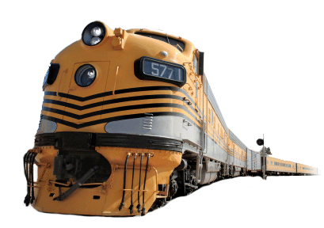
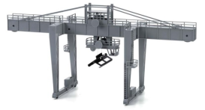
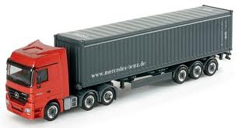
The Project

Slide 5
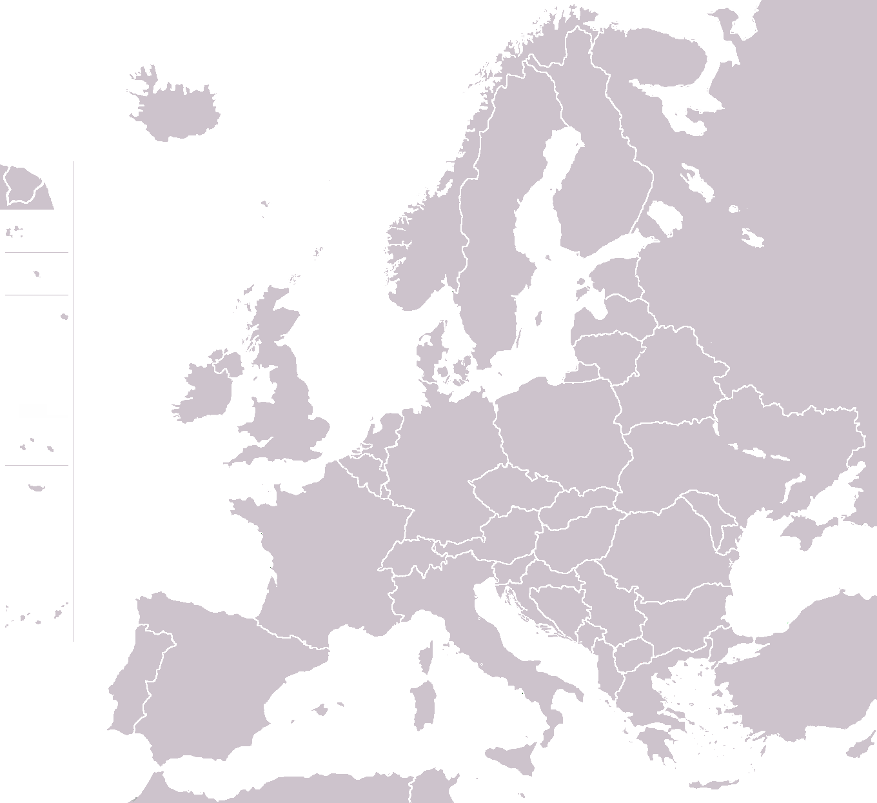
The Project
Example:
Empty miles

Slide 6
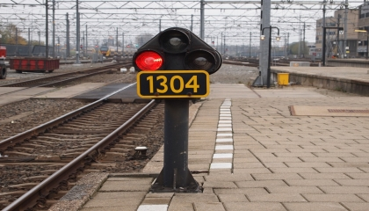
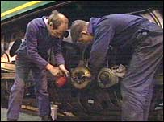
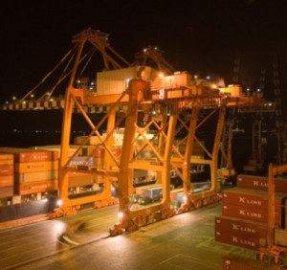
The Project

Slide 7
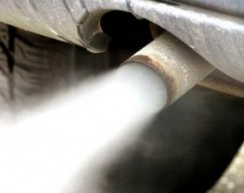
The Project
Example:
Multi-modality

Slide 8
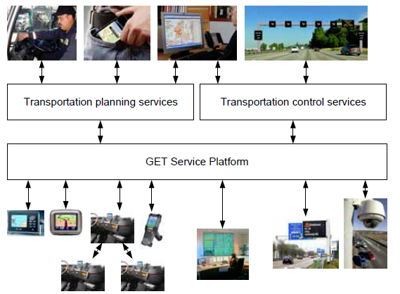
Project Structure
Real-time planning
Real-time control
Real-time information aggregation

Slide 9
The Process

Slide 10
The Process
refine idea
initial idea,
core consortium
write proposal
refine consortium

Slide 11
The Process
The idea and the ‘core consortium’
Who do you like?
What do you work on together?

Slide 12
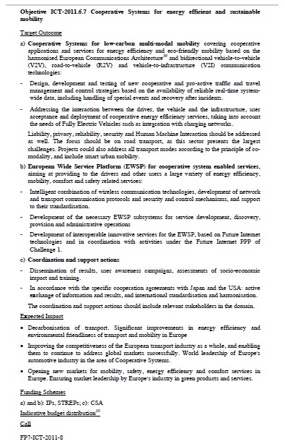
The Process
Elaborating on the idea:
How does it fit with the FP?

Slide 13
The Process
Elaborating on the idea:
How does it fit with the FP?
Information from: Innovation Lab, NCP, EC
Do a pre-proposal check

Slide 14
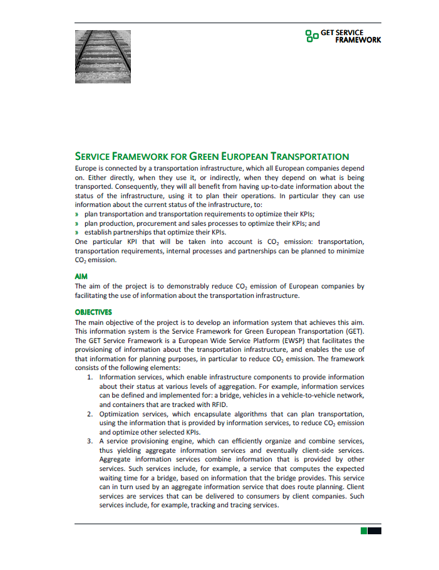
The Process
Expanding the consortium
Become a sales person:
Don’t be shy
Don’t be modest
Notes:
Just contact everybody
Use your partner’s contacts (but you probably have to do the footwork)
Have your story ready (elevator pitch)
If you do the work, people will constantly tell you what a great job you are doing (probably mostly because they don’t have to do it themselves)

Slide 15
The Process
Expanding the consortium
Some rules
Best of breed
Past (European) performance
The consortium has to form a logical whole
DON’T SETTLE
Notes:
Universities are (too) easy
European experience: they know how to play the game; the EC likes it
The consortium is one of the three evaluation factors

Slide 16
The Process
Expanding the consortium
Some rules
Best of breed
Past (European) performance
The consortium has to form a logical whole
DON’T SETTLE

Slide 17
The Process
The Proposal
Only after the idea and consortium are ready
Mainly
WP Structure
Distribution of Work
Quite a puzzle and a lot of interaction with partners

Slide 18
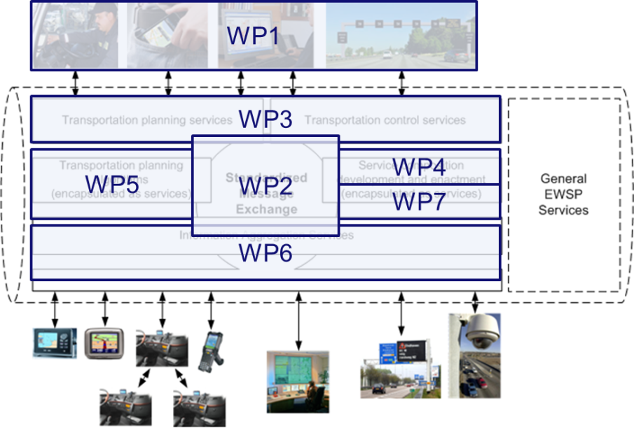
The Process
The Proposal
Tools:
Framework
Template
Previous (successful) proposals

Slide 19
The Process
The Proposal
Be a salesperson:
Don’t be modest
Show that you have what it takes
Notes:
Your project is the best thing that ever happened to Europe

Slide 20
The Process
The Proposal
Involve partners on concrete identifiable parts:
Work Package / Task descriptions
Partner descriptions
State of the Art
Budget
You do the integrating work

Slide 21
The Process
t – 6M
t – 5M
t – 2M
t = 0
refine idea
initial idea,
core consortium
write proposal
refine consortium
3MM
Notes:
Lot of work
Also fun

